Slide 1
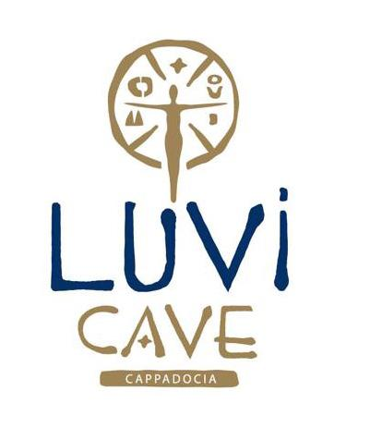
LUVI CAVE HOTEL SUSTAINABILITY REPORT
2022 - 2023

Slide 2
CONTENT
3. ABOUT the SUSTAINABILITY REPORT
4. MESSAGE of the GENERAL MANAGEMENT
5. ABOUT LUVI CAVE HOTEL
6. OUR VISION, MISSION AND VALUES
7. OUR SUSTAINABILITY ROADMAP
8. OUR APPROACH TO SUSTAINABILITY
9-10. OUR SUSTAINABLE MANAGEMENT PRACTICES
11. COMMUNICATION with STAKEHOLDERS
12. OUR SUSTAINABILITY PRACTICES
13. RECYCLING and RENEWABLE ENERGY
14. CHEMICAL CONSUMPTION
15. OUR SOCIAL RESPONSIBILITY PROJECTS

Slide 3
ABOUT the SUSTAINABILITY REPORT
In the sustainability report we have published as Luvi Cave Hotel, our goal is to share the work we carried out in the environmental and social fields along with our future aims about this issue with you, our stakeholders.
The Report covers the data between 01.01.2023 and 31.12.2023.
We aim to continuously improve our sustainability-related activities with the valuable opinions and suggestions of you as our stakeholders. Therefore, our contact information for any feedback is provided below for your information.
Person in Charge: Deniz Turgut / Luvi Cave Hotel General Manager
E-mail : info@luvicavehotel.com
Mobile : 0 536 495 08 78
Address : Aydinli Orta Mahallesi Çakır Sokak No:8 Goreme/Nevsehir

Slide 4
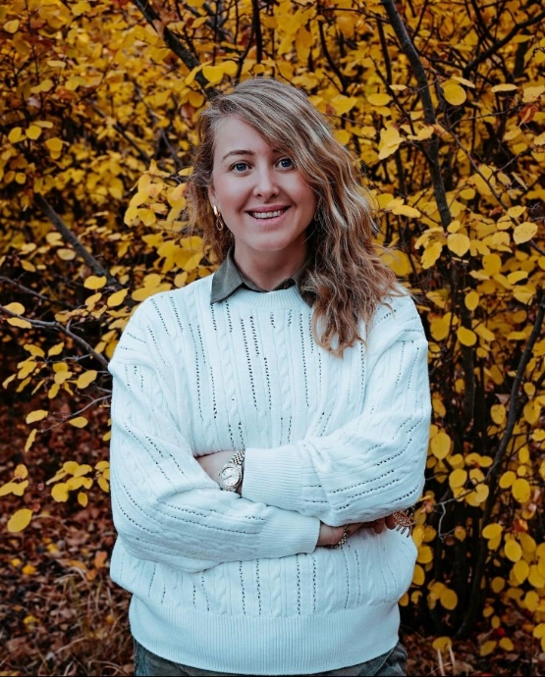
MESSAGE of the GENERAL MANAGEMENT
Luvi Cave Hotel, which has been providing boutique hotel services to its guests since 2021, welcomes guests looking for both a cultural and historical holiday with a total of 12 rooms 8 of which are cave rooms.
Today, our facility, which hosts guests from various parts of Turkey and the world, continues to offer services that aim to ensure and exceed guest satisfaction at the highest level.
It is the mission of Luvi Cave Hotel to add value to our stakeholders and become a leader in tourism by applying sustainable tourism principles with the participation of all our employees.
We will continue to provide honest, hard-working and reliable service with our open, transparent management style and professionalism principles.
Deniz Turgut
General Manager

Slide 5
ABOUT US
Our hotel is named after The Luwians, one of the ancient peoples of Anatolia who lived around 2300 BC. The Luwians, who lived in Anatolia during the Iron Age, were known as the "People of Light" and are the source of the word light, which exists in many languages ​​today: “Light” in English, “Licht” in German, “Lumière” in French, “Luz” in Spanish and many more... We decided to name our hotel Luvi because we wanted these ancient people to shed light on our path, too.
Luvi Cave Hotel is a boutique hotel consisting of a combination of 4 separate buildings located on the same street and used as homes/living spaces for centuries. There are 12 rooms in our hotel, 8 of which are cave rooms and 4 stone ones.
The different exterior and interior designs, decorations and sizes of each room give our hotel a unique character.
Our rooms promise fascinating views and an unforgettable stay via their architecture combining traditional and modern styles with a tasteful touch.
Although our hotel is located in the center of Goreme, it offers a quiet and peaceful accommodation opportunity, away from vehicle traffic and all the chaos and noise caused by it, thanks to its location on a dead-end street.
Our rooftop terraces offer breath-taking views of Goreme and the surrounding valleys with a very wide angle. Despite all the charm of Cappadocia, which is a paradise of outdoor activities; our tastefully decorated Terrace Bar and common outdoor areas make our guests want to spend more time at our hotel.
The presence of our neighbours living in the rock houses on the same street just next to our hotel offers our guests the chance to personally observe the traditional/authentic living conditions of Cappadocia.

Slide 6
OUR VISION, MISSION AND VALUES
LUVI CAVE HOTEL VISION
To become a reliable brand at home and abroad
To maintain healthy growth and development in our industry
Diversification in integrity
LUVI CAVE HOTEL MISSION
To provide our guests with the highest level of service that will make them feel special whilst respecting the environment and social values.
To provide constantly improving services following innovations
LUVI CAVE HOTEL VALUES
Openness, Transparency, Professionalism, Reliability, Fairness, Efficacy, Teamwork, Respect, Environmental Awareness, Animal Friendliness

Slide 7
OUR SUSTAINABILITY ROADMAP
OUR APPROACH TO SUSTAINABILITY
Environmentally and Animal Friendly…
Our hotel, placed among historical and cultural beauties, adopts a tourism approach that does not destroy our history and cultural heritage, but coexists with the surrounding nature and cultural richness.
Our animal-friendly hotel provides food supplement for the habitats of wild animals in our region at certain periods throughout the year.
As Luvi Cave Hotel, we carry out many activities to provide social benefit. We will continue to carry out these activities to provide social benefit and add value to our stakeholders.

Slide 8
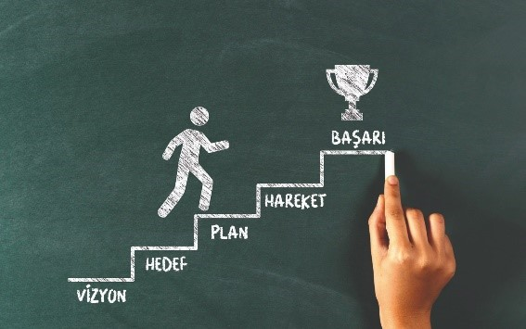
OUR APPROACH TO SUSTAINABILITY
OUR GOALS:
Improving communication with stakeholders
Developing methods to share our sustainability efforts with our stakeholders more effectively
Optimization in data collection processes
Conducting studies to set our goals more effectively to achieve results by reviewing the sources used in data collection
Compliance with international standards
Occupational health and safety

Slide 9
OUR SUSTAINABLE MANAGEMENT PRACTICES
To ensure that no work accidents occur by ensuring all occupational safety and work-related conditions for our employees and subcontractors
COMPLIANCE with the LAWS:
Our facility operates in compliance with national and international laws.
Our facility received the Safe Tourism Certificate in 2021.
CORPORATE MANAGEMENT:
Our facility provides corporate management principles with open, transparent, professional, reliable and fair sustainability principles.
INTERNATIONAL MANAGEMENT STANDARDS:
In addition to working in compliance with legal regulations, our facility provides services at international standards. The standards applied are as follows:
Occupational health and safety

Slide 10
OUR SUSTAINABLE MANAGEMENT PRACTICES
SUSTAINABILITY IN PURCHASING
1. Locally made manufactured goods are purchased instead of imported products except in cases where the latter is mandatory for our business,
2. Local companies are preferred to multinational companies when purchasing services at non-essential points.
3. Class A and/or alternatives that consume less energy are preferred for the machinery and equipment to be purchased.
4. While purchasing products, those made from recycled products or those that can be recycled are preferred.
Goods, products and equipment that are purchased are supposed to meet the following criteria:
  Sustainably produced/sustainably sourced
  Fair Trade/Organic
  Delivered with less packaging
  Energy and water saving
SUPPLY CHAIN
Luvi Cave Hotel prefers to work with local suppliers in order to support employment growth in its region.
OUR WORKING LIFE
Annual on-the-job training plans are made for all our employees, and training regarding the operations and functions of the departments they work in continues to be provided by our managers or outsourced experts.

Slide 11
COMMUNICATION with STAKEHOLDERS
STAKEHOLDERS | COMMUNICATION METHOD | FREQUENCY of COMMUNICATION
EMPLOYEES | One-on-one meetings | Frequently
 | Performance evaluation | Frequently
 | Occupational health & safety meetings | Once in 2 weeks
GUESTS | Call centre | Frequently
 | Email | Frequently
 | Seminar, congress and exhibition | Once a year
SUPPLIERS | Meeting | When requested
 | Email | Frequently
LOCAL GROUPS | Social projects | Throughout the project
PUBLIC ORGANISATIONS | Meeting | Whenever set
 | Information forms | At least once a year
 | Audits | At least once a year
SECTORAL ORGANISATIONS | Meetings | Whenever set
 | Seminars and exhibition | At least once a year
MEDIA | Interviews | When needed
 | Press release | When needed
As Luvi Cave Hotel, we aim to develop and improve our sustainability efforts by sharing them with our stakeholders, and we carry out our work to ensure sustainable development by ensuring the participation of our stakeholders.

Slide 12
OUR SUSTAINABILITY PRACTICES
OUR ENVIRONMENTAL APPROACH
RECYCLING and RENEWABLE ENERGY
Recyclable materials are sorted in our facility.
Solar panels are used in our facility.
In 2021-2022, hazardous waste was delivered to licensed companies to preserve the nature.
Thanks to the calls we made on social media to clean up the waste thrown into the nature in our region in 2023, we cleared the garbage in the valleys and we will continue to do so.
In order to reduce carbon footprint and prevent air pollution, we recommend our guests to use public transportation, cycle or walk.

Slide 13
RECYCLING and RENEWABLE ENERGY
We use electricity card system to cut off the electrical power after our guests leave the room.
75% of our lighting systems are compact fluorescent bulbs and LED lighting
Mini bars in guest rooms are positioned out of direct sunlight to prevent heating.
A time clock is used in outdoor lighting. Lighting times are adjusted according to summer and winter hours.
Electricity consumption is reduced via frequency inverters in heating system pumps, booster pumps and air conditioners.
Luvi Cave Hotel has solar panels and some of the hot water needs are provided by these panels. In this way, our hotel limits the consumption of electricity generated by power plants.

Slide 14
CHEMICAL CONSUMPTION
We provide continuous training to our staff to ensure that chemicals are used in sufficient quantities to ensure general hygiene in our facility.

Slide 15
SOCIAL RESPONSIBILITIES
We donated saplings to the TEMA foundation in order to compensate for the damage we have caused to the nature.
We regularly donate food to stray animals.
Our facility cleans the area in the valleys once a year in order to protect the nature.

